Slide 1


Intelligent Farm Operations Platform with Smart Agro Precision System.
Mentor
Ragul S
Farming : Crop Recommendations, Disease Detection,
Smart Irrigation, Satellite & Drone Monitoring
and Farmer Analytics.
Team A members
Aasima
Tejaswini
Anshul Chaurasiya
Ashutosh Mishra
Charitha S

Slide 2
⚠️ Problem Statement
Challenges Faced by Farmers
1️⃣
No Real-Time Monitoring
2️⃣
Resource Wastage
3️⃣
Unpredictable Weather
Manual observation.
Delayed detection of crop stress.
Over-irrigation wastes 40-60% water.
Excess fertilizer degrades soil.
No early warning systems.
Crop failure from sudden changes.
4️⃣
Late Pest Detection
5️⃣
No Expert Access
6️⃣
Fragmented Data
Identified too late.
₹90,000 Cr+ annual crop loss.
Small farmers lack guidance.
Language barriers.
No centralized platform.
Decisions based on intuition.
5/21

Slide 3
OBJECTIVES-FARMEVERSE
  FarmVerse is a smart farming platform designed to support farmers in managing their farms more effectively.
  It helps farmers make informed decisions to improve crop growth and productivity.
  It promotes the efficient use of resources such as water, fertilizers, and land
  It assists in monitoring farm conditions and responding to changes in weather.
  It helps in detecting the disease early.
  Improves overall farm productivity while reducing operational cost.
  Support timely decisions for better farming outcomes.
  Encourage sustainable and environmentally friendly farming practices.
  Increase farmers' profitability by optimizing the use of available resources

Slide 4











FarmVerse
Precision Agriculture Management Platform — Modules
Farmer Register Module
Farm Management Module
Sensor Monitoring Module
Weather Monitoring Module
Smart Irrigation Module
faremer create an account
Add & manage fields, crops and daily farm activities
Live soil moisture, temperature , humidity ,soil pH, High Intensity, Water level
Real-time forecasts, rainfall & climate risk updates
scheduling to save water ,Prevents over-irrigation,reduce electricity cost
Crop Recommendation Module
Disease Detection Module
Fertilizer Recommendation Module
Alert Module
Dashboard Module
based on soli pH,temparature,humidity,rainfall
Image-based detection of crop diseases at early stage
Suggests right fertilizer type & dosage for each crop
Instant SMS/app alerts for risks, weather & sensor events
Unified view of farm health, analytics & reports

Slide 5
🌟 Unique Features
How FarmVerse Works Differently
🗺️
🤖
💧
Smart Dashboard
AI Crop Advisory
Smart Irrigation
Map-based field viz
Real-time sensor overlay
Zone your farm into parcels
Upload leaf → instant detection
50K+ disease images trained
Works with smartphone
Soil moisture + weather API
AI calculates exact water
Automated scheduling
✨ Geospatial + temporal fusion
✨ Camera-based, no hardware
✨ Saves 30-40% water
8/21

Slide 6
🌟 More Unique Features
Setting FarmVerse Apart
🌤️
🐛
📈
Weather
Pest Prediction
Yield Prediction
Micro-level predictions
Field-specific alerts
Frost/heatwave/rain warnings
7-14 day advance alerts
Weather + historical data
Preventive approach
ML-based forecasting
Historical trends
Market strategy planning
🛒
Marketplace
🗣️
Voice Assistant
📱
Offline-First
Buy seeds/fertilizers
Sell produce directly
Fair pricing
Local languages
Voice-based advisory
For non-tech farmers
Works without internet
Syncs when connected
Rural India ready
9/21

Slide 7
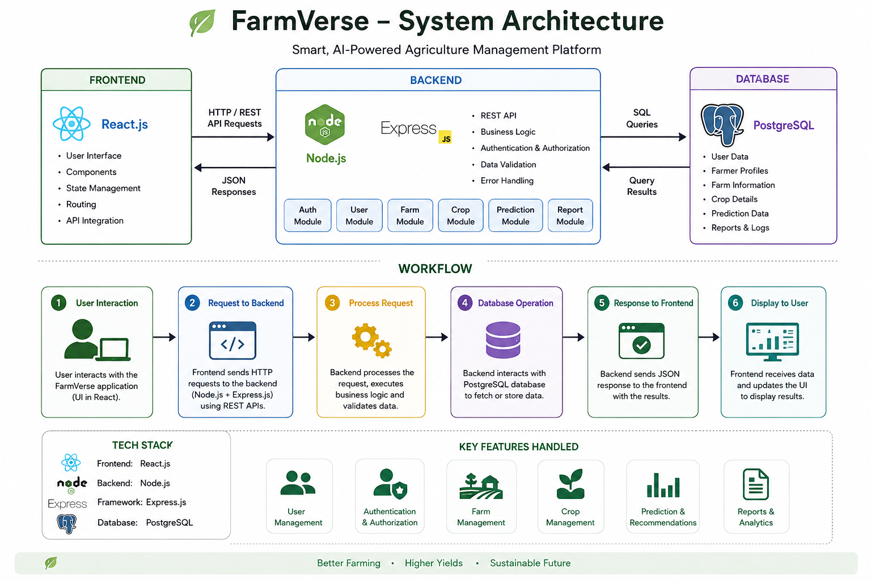
🏗️ System Architecture
Smart, AI-Powered & Connected Farming Platform

Slide 8
💻 Technology Stack
Tools & Technologies
FRONTEND
BACKEND
AI/ML
⚛️ React.js
🟢 Node.js + Express
🧠 TensorFlow / PyTorch
📱 Flutter /
🐍 Python FastAPI
👁️ OpenCV
🎨 Tailwind CSS
🔗 GraphQL + REST
📈 Scikit-learn
🔐 JWT Auth
🟢 Spring boot
DATABASE
IoT & CLOUD
EXTERNAL APIs
🐘 PostgreSQL
📡 MQTT Protocol
🌤️ OpenWeatherMap
🍃 MongoDB
☁️ AWS / Azure
🐳 Docker + K8s
🔄 GitHub Actions
12/21

Slide 9
🔑 Key Features
Platform Capabilities
🗺️
Smart Map
🤖
AI Advisor
💧
Irrigation
🌤️
Weather
🐛
Pest Control
📈
Analytics
🛒
Marketplace
🗣️
Voice Bot
👨‍🌾
Community
📱
Mobile App
🔔
Alerts
📊
Reports
13/21

Slide 10
✅ Benefits
Impact & Advantages
👨‍🌾
🌍
💰
FOR FARMERS
FOR ENVIRONMENT
FOR ECONOMY
📈 20-30% yield increase
🧪 Reduced chemical runoff
📈 Higher profitability
💧 30-40% water savings
💧 Water conservation
🍎 Reduced food waste
🧪 25% less chemicals
🌱 Sustainable farming
🌐 Rural digitization
💰 Better market prices
🌡️ Lower carbon footprint
👩‍💻 Agri-tech jobs
14/21

Slide 11
🚀 Future Scope
🛰️
🤖
📊
Satellite Imagery
Drone Monitoring
Advanced Analytics
NDVI crop health from space
Large-scale monitoring
Detect stress before visible
Automated aerial surveys
Precision spraying
3D terrain mapping
ROI calculators
Carbon credit tracking
Water footprint analysis
15/21

Slide 12
🏛️
🌐
🧬
🚜
Govt Integration
IoT Expansion
Crop Genome DB
Autonomous Farming
PM-KISAN link
Crop insurance
Subsidy recommendations
Smart greenhouses
Livestock monitoring
Aquaculture integration
AI-recommended varieties
Soil-crop matching
Hybrid seed suggestions
Robot harvesting
Self-driving tractors
Automated planting
16/21

Slide 13
Thank You

